Slide 1


Erb yacht & charter
Frontend Webpage
Team Members:
(22) Alin
(02) Rayner Chung
(24) Joe Chu
(19) Billy Wong

Slide 2
Table of Contents
01
Background
02
Difficulties
03
Pages Hightlights
04
Conclusion
Provide an overview and highlight the project's main advantages
Introduce the sitemap, UML & challenging's of this webpage
Demonstrate the purpose and functionality of each page
Discuss overcoming obstacles and thoughts on the project

Slide 3
01
Background
Overview and highlight the project's main advantages

Slide 4
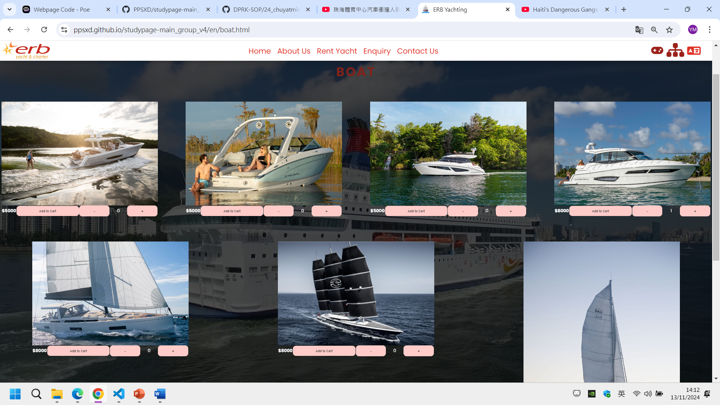
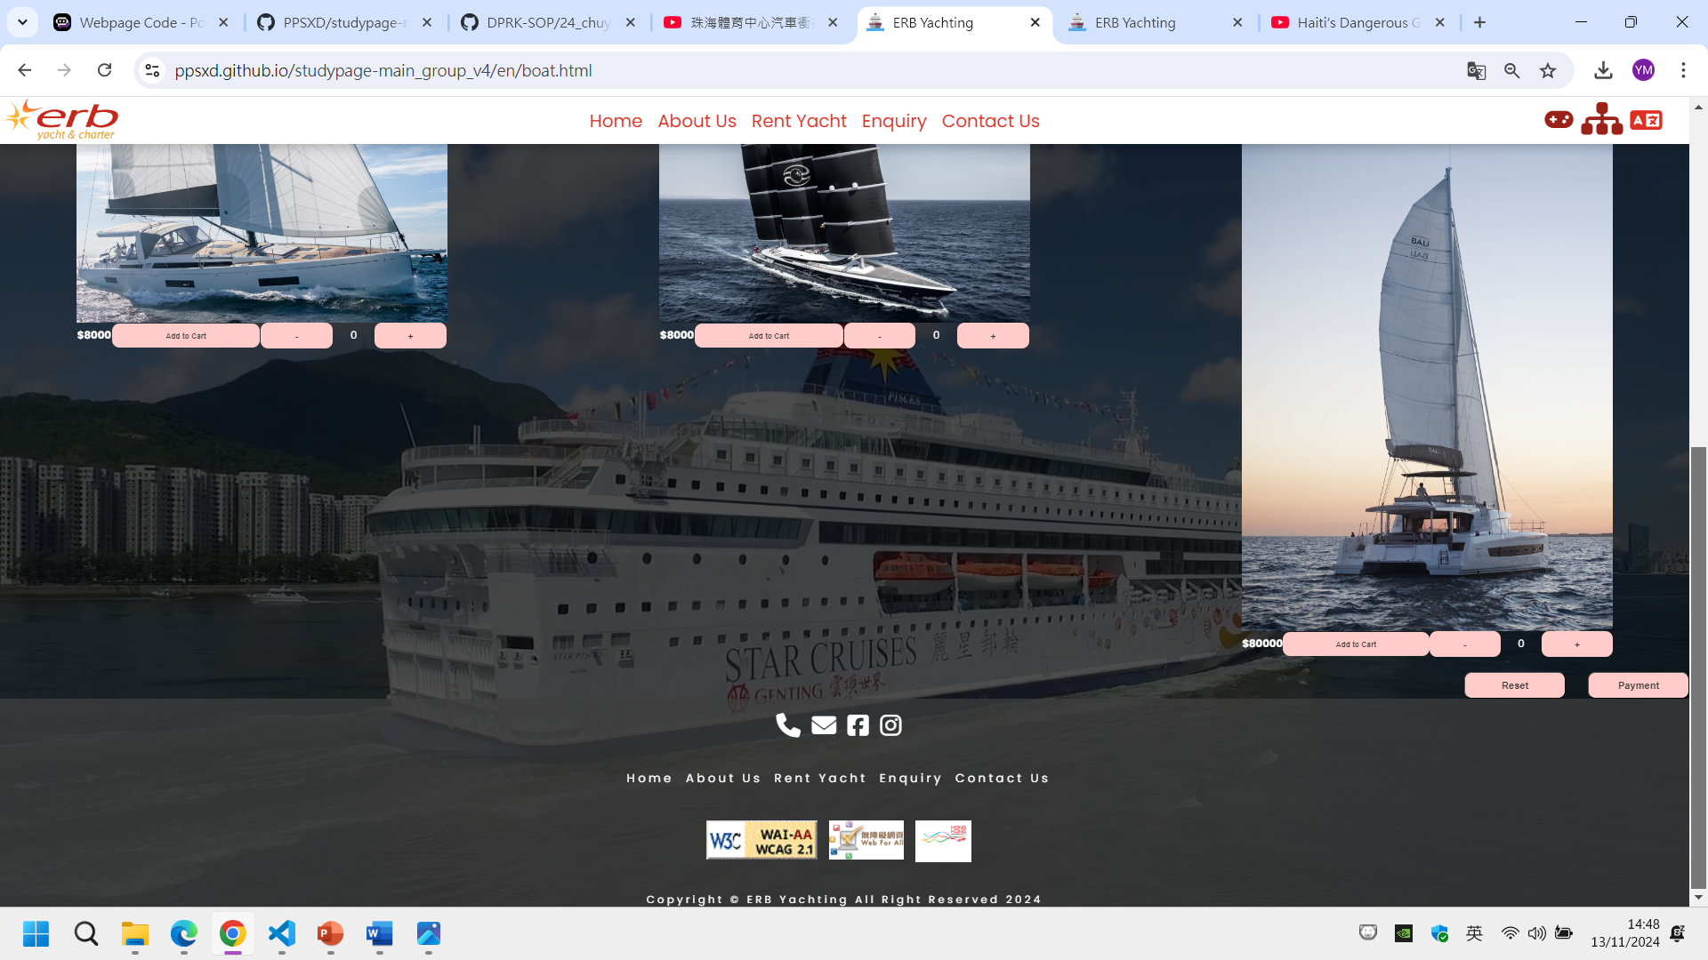
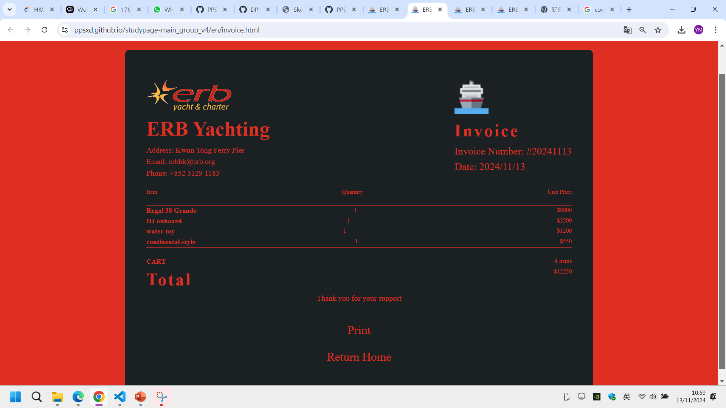
User Experience Enhancement
Boat & Service Selection
Check Out
Invoice Generation
User select boat and services from separate pages
Consolidate various to calculate the amount
Breakdown is clearly shown on the invoice

Slide 5
02
Difficulties & Challenging
Introduce the sitemap, UML & challenging's of this webpage

Slide 6
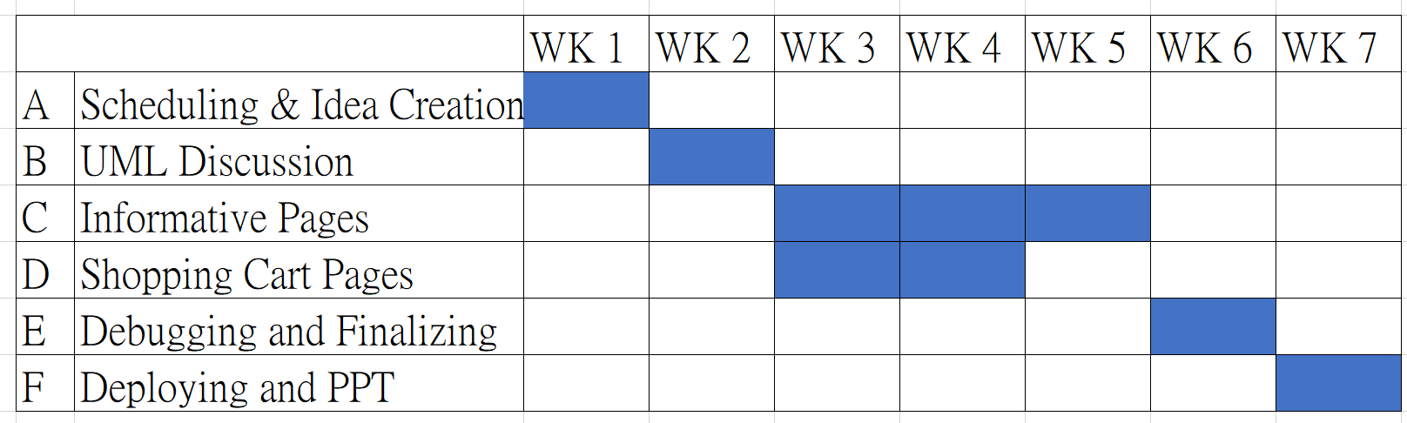
Gantt Chart & PERT Chart
C
Start
A
B
E
F
End
D

Slide 7
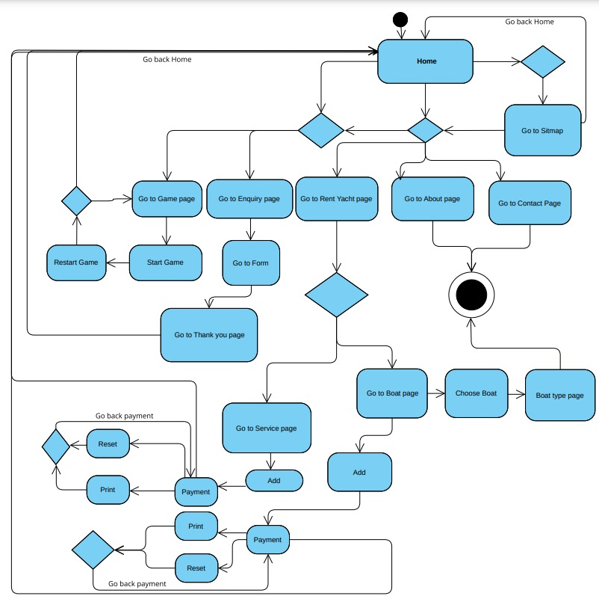
UML Diagram

Slide 8

Difficulties & Challenging
Enhance Customer Journey
Redesign the customer journey to improve user experience and increase satisfaction.
Implement Shopping Cart Functionality
Integrate a shopping cart feature with backend support to streamline the purchasing process.
Utilize JavaScript
Adopt JavaScript on the webpage to create dynamic and interactive elements that enhance user engagement.

Slide 9
03
Pages Highlights
Demonstrate the purpose and functionality of each page

Slide 10
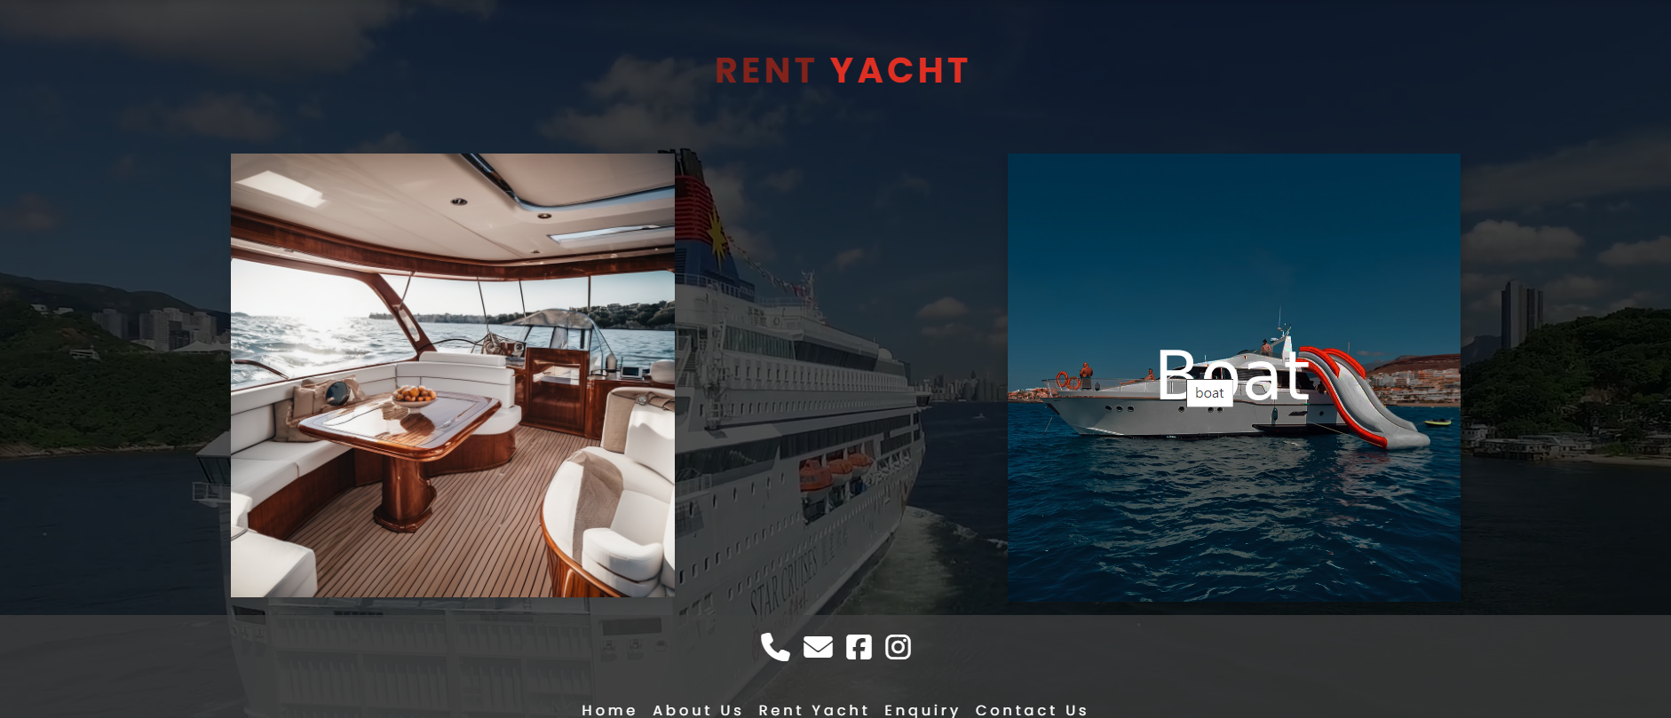
Rent Yacht Page

Slide 11
Rent Yacht Page

Slide 12
Rent Yacht Page

Slide 13
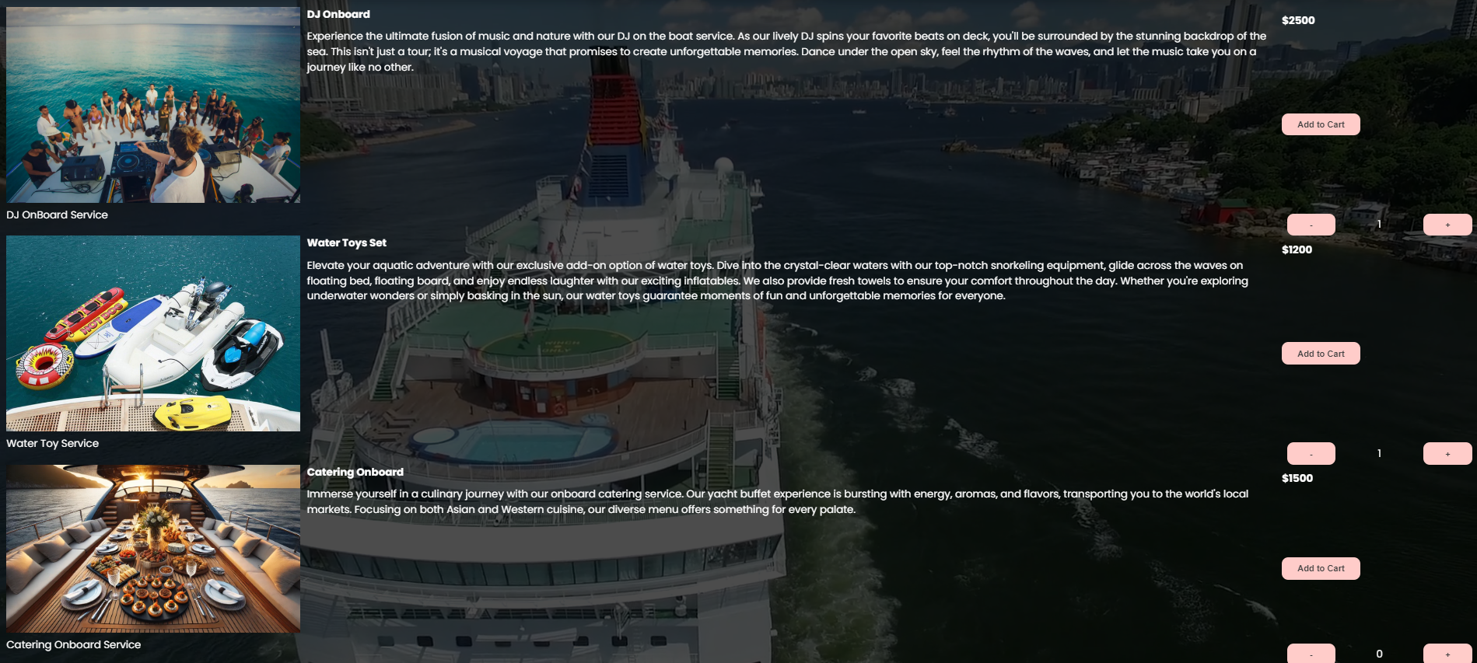
Service Page

Slide 14
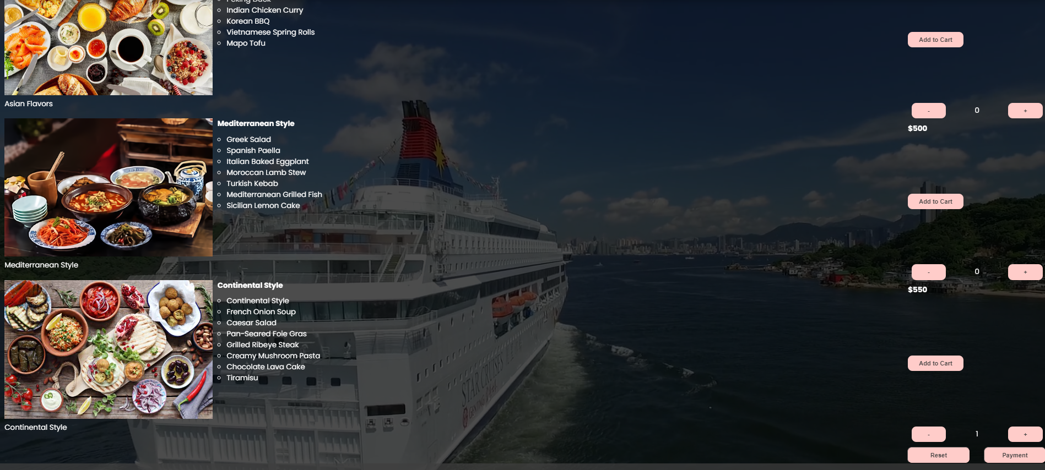
Service Page

Slide 15
Checkout Page

Slide 16
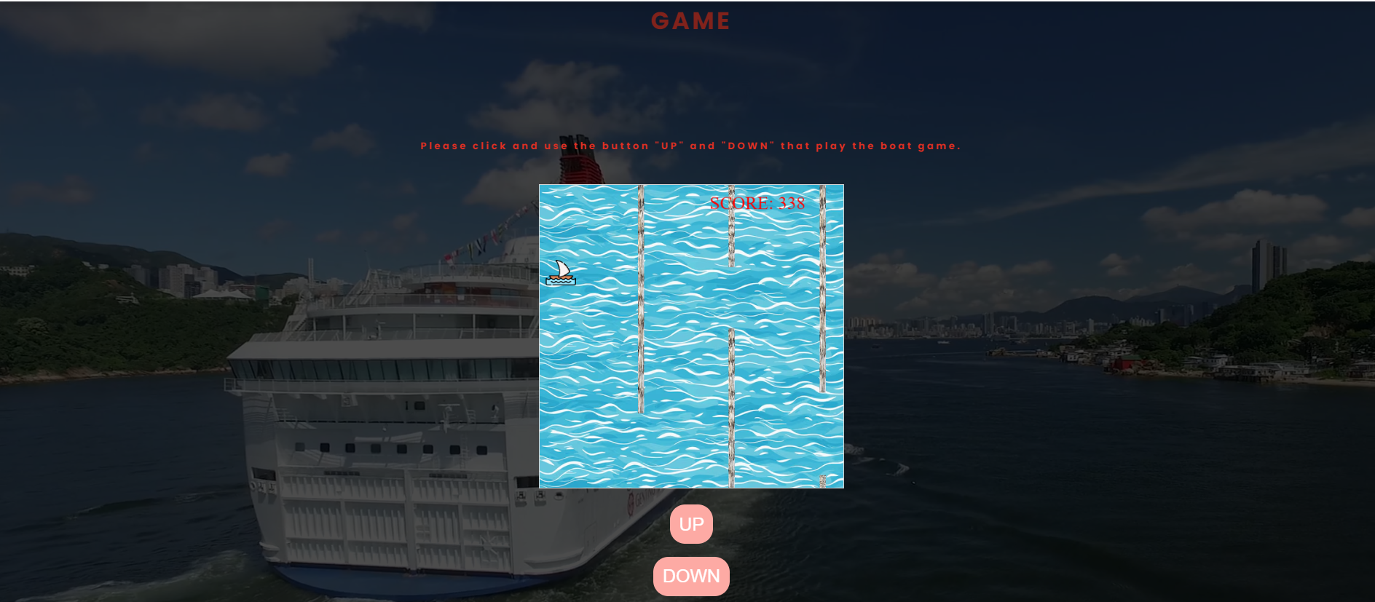
Game Page
Different versions for mobile, tablet, and laptop.

Slide 17
04
Conclusion
Discuss overcoming obstacles and thoughts on the project

Slide 18

Achievements
1. Successfully built and deployed a website that fits the business purpose.
2. Adopted various languages (HTML, CSS, JavaScript) and techniques learned from the lessons.
3. Conducted troubleshooting, testing, and debugging throughout the development phase, ensuring the webpage meets commercial standards.

Slide 19

Q&A

